Slide 1
MongoDB - Create Collection
Options parameter is optional, so you need to specify only the name of the collection.
Syntax
db.createCollection(name, options)
Parameter | Type | Description
Name | String | Name of the collection to be created
Options | Document | (Optional) Specify options about memory size and indexing

Slide 2
MongoDB - Create Collection
Commands
> use employeedb
> db
> db.createCollection("employee")
> show collections
In MongoDB, you don't need to create collection. MongoDB creates collection automatically, when you insert some document.
Command
db.city.insert({"cityName":"Bangalore"})

Slide 3
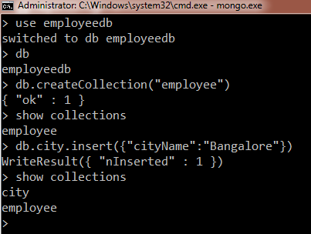
MongoDB - Create Collection

Slide 4
MongoDB - Create Collection
List of options
db.createCollection(name, options)
Field | Type | Description
capped | Boolean | (Optional) If true, enables a capped collection. Capped collection is a fixed size collection that automatically overwrites its oldest entries when it reaches its maximum size. If you specify true, you need to specify size parameter also.
size | number | (Optional) Specifies a maximum size in bytes for a capped collection. If capped is true, then you need to specify this field also.
max | number | (Optional) Specifies the maximum number of documents allowed in the capped collection.
autoIndexId | Boolean | (Optional) If true, automatically create index on _id fields Default value is false.
While inserting the document, MongoDB first checks size field of capped collection, then it checks max field.

Slide 5
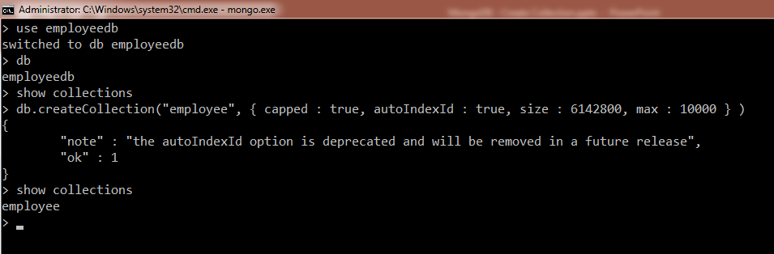
MongoDB - Create Collection
Commands
> db.createCollection("employee", { capped : true, autoIndexId : true, size : 6142800, max : 10000 } )

